Slide 1
Data Structures and Algorithms INFO-3135
Recursive Sort Algorithms

Slide 2
Recursion

Slide 3
Recursion
We are familiar with repetition in the form of loops, for(), while().
Another way to achieve repetition is through recursion, which occurs when a function refers to itself in its own definition
Functions can call other functions obviously, so it should come as no surprise that C++ allows a function to call itself
To understand recursion in function calls we need to understand what happens when a C++ function is called.

Slide 4
Function calling
Parameters are initialized and values are set
The function is called and control is passed to the function
Once this function has completed, execution continues from where the function was called
Other information the system needs to properly execute the function also needs to be stored somewhere.
Dynamic allocation using the runtime stack is used for this purpose
Each function call gets pushed onto the stack with its information
Each function is identified uniquely on the stack which allows the distinction between variables with the same name.
This is important for recursive functions especially

Slide 5
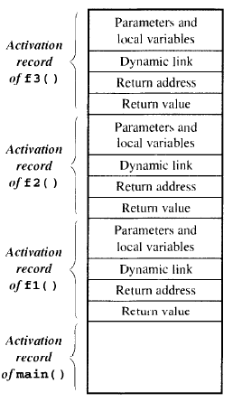
Function Calling
The state of each function is characterized by its variables, parameter values and return address.
The data area that contains this information is called the “Activation Record” or “Stack Frame”
An activation record exists for as long as the function owning it is executing
Only the activation record of main() outlives every other activation record.
The diagram shows main() calls f1() which calls f2() which calls f3()
When f3() completes, its activation record is popped off the stack and f2() resumes.

Slide 6
Recursive Functions
Recursion is calling a function that has the same method signature as the caller.
Therefore, a recursive function call is not really a function calling itself but an instantiation of a function calling another instantiation of the method definition.
Each call to the function will have its own activation record
Let's look at an example using the function: int power( int base, int n );
This function will raise any number base to the power of n

Slide 7
Recursive Power
int power(int base, int n ) {
if( n == 0)
return 1;
else
return base * power( base, n - 1);
}
Let try this in Visual Studio

Slide 8
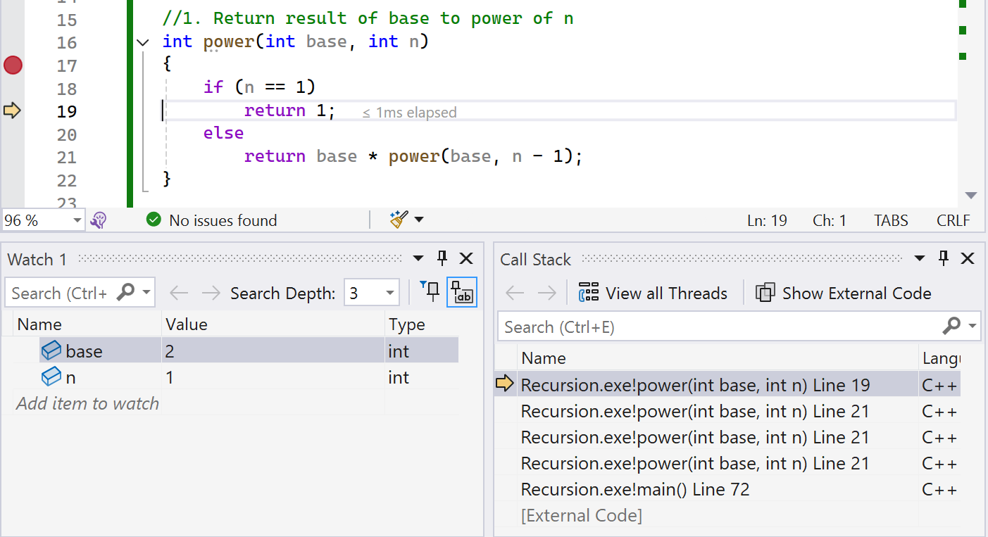
Example of Debugger – Call Stack
int main()
{
int result = power(2,4);
}

Slide 9
The logic of power
The power function will continue to recursively call until the n-1 causes the if( n== 0 ) return 1.0 to execute
The last recursive call is called the anchor (the last step in a chain of recursive calls)
The anchor ensures we don’t fall into an infinite loop
The anchor produces 1 because of raising x to the power of 0
The result is passed back to the previous call which returns x * 1
The third call result is passed back to the previous call which returns x * x
Etc.

Slide 10
Non-recursive, iterative version of power
int power( int base, int n ) {
int result = 1;
while (n >= 1) { result *= base;
--n
}
return result;
}

Slide 11
Benefits
Is recursion better?
Our example is small, and the non-recursive version is not much larger that the recursive
In general, recursive functions:
Are smaller, less code
Can be more intuitive
Have improved readability
Have improved self-documentation
Can simplify coding

Slide 12
Finally – 3 types of recursion
Linear – makes at most one recursive call each time it is invoked
Useful when viewing algorithmic problems in terms of a first and last element or when working with a remaining set that has the same structure as the original set
Binary – when an algorithm makes two recursive calls
Useful for example, when we need to solve two similar halves of some problem
Multiple – when an algorithm makes more than two recursive calls
May make multiple recursive calls, with that number potentially being more than two.

Slide 13
Recursive Sort Algorithms: Merge Sort

Slide 14
Merge Sort – How it works
Merge sort takes a divide and conquer approach
The array is recursively split into two halves until each half contains a single element (or no elements)
Then these halves are merged back together in sorted order
Merge sort is an example of binary recursion
In merge sort you split the array into two halves by making two recursive calls:
One to sort the left half
One to sort the right half

Slide 15
Merge Sort – The Algorithm
If the list has 0 or 1 elements, it is already sorted. This is the base case.
Otherwise:
Divide the list into two halves: a left half and a right half.
Recursively apply merge sort to the left half. This means sort the left half using the same method.
Recursively apply merge sort to the right half. Sort the right half the same way.
Merge the two sorted halves:
Create an empty list for the result.
While both halves still have elements:
Compare the first element of each half.
Take the smaller element and add it to the result list.
When one half is empty, copy the remaining elements of the other half into the result list.
Return the merged result list.

Slide 16
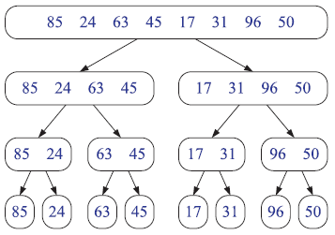
Merge Sort – The Process
Suppose you have an array: [85, 24, 63, 45, 17, 31, 96, 50]
1. Divide
Split array into halves until each piece has just one element
2. Merge
[85] and [24] becomes [24, 85]
[63] and [45] becomes [45, 63]
[17[ and [31] becomes [17, 31]
[96] and [50] becomes [50, 96]
Keep merging
[24, 85] and [45, 63] becomes [24,45,63,85]
[17,31] and [50,96] becomes [17,31,50,96]
Final merge
[24,45,63,85] and [17,31,50,96] becomes [17,24,31,45,50,63,85,96]

Slide 17
Merge Sort – Uses Two Functions
mergeSort()
recursively divides the array in half
then each is half is divided in half
this continues until base case
base case is when the array is divided into a length of one, which is by definition sorted
merge is called for each halved array
merge()
merge is called on each small array
the array is divided in half
each half is merged in sorted order
merge the two halves to get the final sorted array

Slide 18
Let’s code a Merge Sort

Slide 19
Recursive Sort Algorithms: Quick Sort

Slide 20
Quick Sort – How it works
This sort algorithm is also based on the divide-and-conquer algorithm
This sort algorithm is also an example of binary recursion
Steps:
Pick a value from array, for example, the first, last, middle, or a random element. This is called the pivot
Partition the array so that:
All elements < pivot come before it
All elements > pivot come after it
The pivot is now in its final sorted position
Recursively apply quicksort to left half and then to right half
If the array has 0 or 1 elements, it’s already sorted

Slide 21
Quick Sort – The Process
Array To Sort [38, 27, 43, 3, 9]
Choose pivot, for example, the first element = 38.
Partition → [27, 3, 9] [38] [43]
Left part [27, 3, 9]:
Pivot = 27
Partition → [3, 9] [27] []
Left part [3, 9]:
Pivot = 3
Partition → [] [3] [9]
Now recombine: [3, 9] [27] [38] [43] → [3, 9, 27, 38, 43]

Slide 22
Quick Sort – Uses Two Functions
quickSort()
Calls partition to get a partition index
quickSort is called recursively for both sides of the partition
base case is when the array is divided into a length of one, which is by definition sorted
partition()
rearranges the list by swapping all elements that are:
Less than partition to the left
Greater than partition to the right
Returns the index of the partition

Slide 23
Let’s code a Quick Sort

Slide 24
Fun Videos Of Different Sorts
Bubble Sort:
https://www.youtube.com/watch?v=lyZQPjUT5B4
https://youtu.be/Cq7SMsQBEUw?list=RDCq7SMsQBEUw
Selection Sort:
https://www.youtube.com/watch?v=Ns4TPTC8whw
https://www.youtube.com/watch?v=92BfuxHn2XE
Insertion Sort:
https://www.youtube.com/watch?v=ROalU379l3U
https://www.youtube.com/watch?v=Q1JdRUh1_98
Merge Sort:
https://www.youtube.com/watch?v=XaqR3G_NVoo
https://www.youtube.com/watch?v=ZRPoEKHXTJg
Quick Sort:
https://www.youtube.com/watch?v=Hoixgm4-P4M
https://youtu.be/ywWBy6J5gz8

Slide 25
Uses for Sorting
Bubble Sort Use Cases:
In systems that require simplicity and the dataset is small
Detecting sorted data early, for example, in programming TV remote to sort channels based on longer viewing time
In memory-limited systems, since bubble sort does its sorting in place, does not need additional memory
Cache friendly
Fastest sort of list is already sorted or only one item is out of place

Slide 26
Uses for Sorting
Quick Sort Use Cases:
Efficient for big data, large datasets
does its sorting in place, does not need additional memory
Divide-and-conquer systems by splitting the dataset into smaller sub-arrays, for example, sports scores are organised by quick sort on the basis of win-loss ratio.
Heap Sort: Heap sort is used in reading barcodes on plastic cards.
Merge Sort: Databases use an external merge sort to sort sets of data that are too large to be loaded entirely into memory.

Slide 27
Uses for Sorting
Heap Sort Use Cases:
Heap sort is used in reading barcodes on plastic cards.
Merge Sort Use Cases:
Databases use an external merge sort to sort sets of data that are too large to be loaded entirely into memory.

Slide 28
Which sort?
Each of the algorithms has its limitations.
HeapSort in-place, for example, completely messes up the order of your data, should you interrupt it before it is finished
Other simpler algorithms iteratively improve the sortedness
Believe it or not, there are situations where BubbleSort is not a bad choice.

Slide 29
Useful?
Sorting happens all the time.
Sorting your photos on the phone by date?
Finding users/posts on Instagram
Listing e-mails by sender, then date, etc.
Shortest paths, cheapest items, etc.
Sorting it very closely tied to searching where pre-sorted data is much, much faster to search (often orders of magnitude faster)

